Slide 1
Lecture 18: Software Architecture: Selected Topics
“The Devil in the Details”
Mia Mohammad Imran

Slide 2
Today’s topic
What are those questions
We talk about some of the events happened in real world
We will talk about some questions, some problems and not “so good solutions”
What Are Microservices?
Why don’t we host the server on our premise? Why AWS / Azure?
When (Not) to Add More Servers?

Slide 3
Question on upcoming assessments
Project sprint 1: Nov 4
Project sprint 2: Nov 18 (software architecture/design/start implementation)
Assignment 3: top ⅘ feature implementation applying a design pattern: Nov 21 or 25?
Project sprint 3: Dec 4. Majority feature implementation
Assignment 4: testing: Dec 11
Project finalization (sprint 4): complete MVP: Dec 15
Final: Take home: by Dec 19 5 PM
Nov 20: Project Review (in-class code review)/In class bonus activity with PR in open-source?

Slide 4
Upcoming Lecture Plans
Nov 4/6/13: Design Pattern (likely)
Nov 18: Testing
Dec 02: Testing (likely)
Dec 04: CI/CD (DevOps overview)
Dec 09: Project Review/Special Topic/Presentation
Dec 11: Project Review/Special Topic/Presentation (wrap up/final exam topics overview)

Slide 5
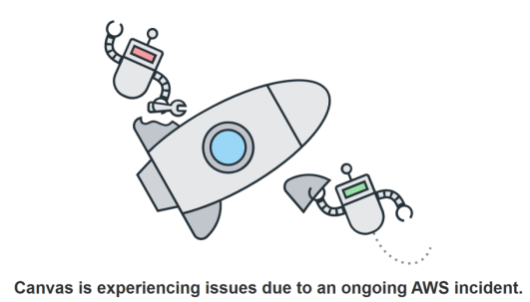
Event 1: AWS Crashed (2025)

Slide 6
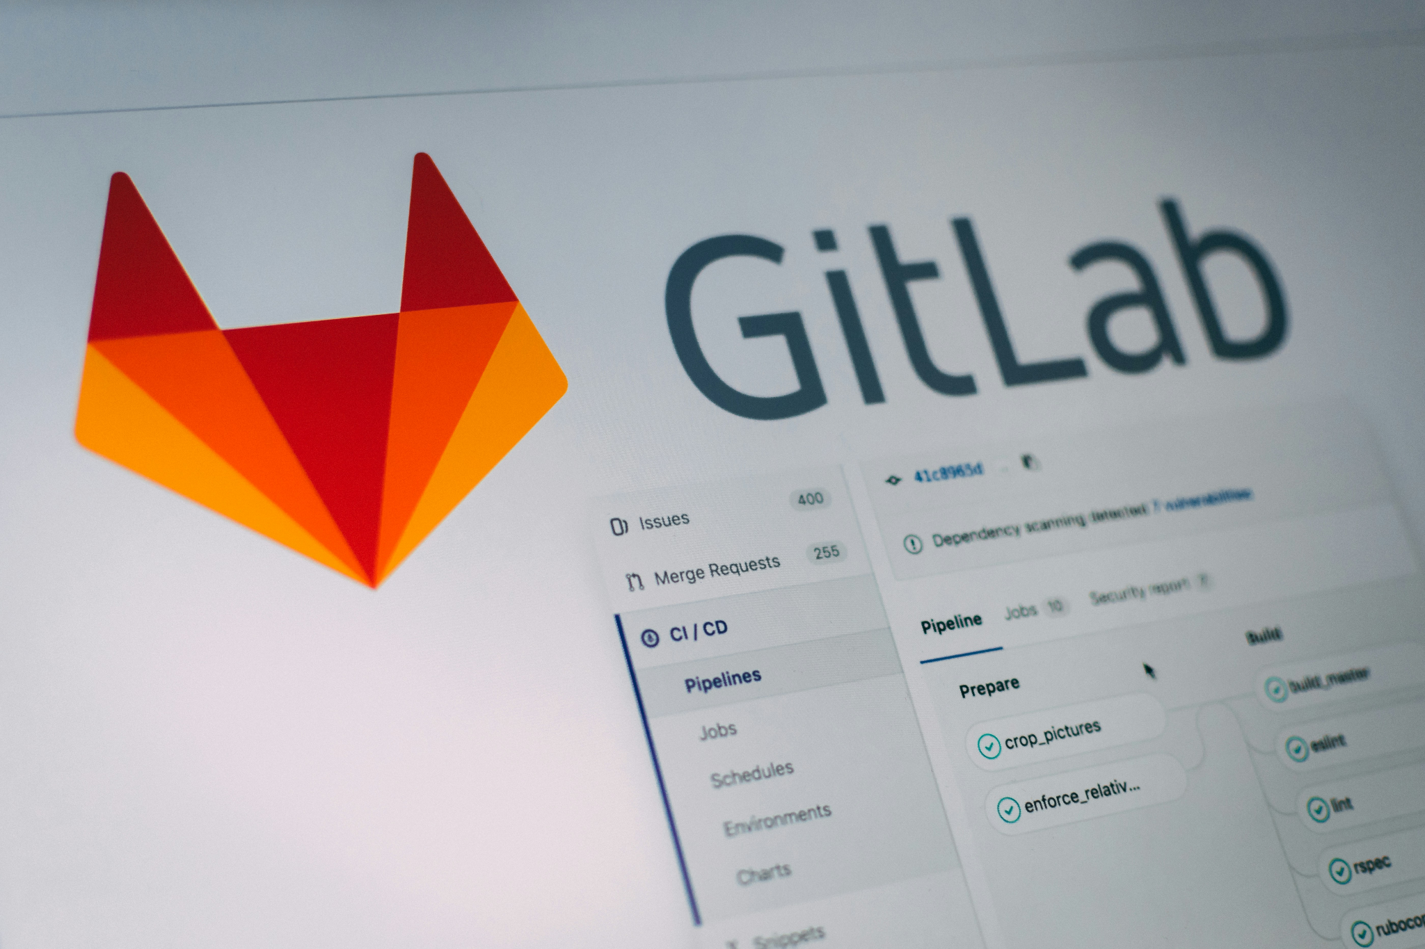
Event 2: GitLab disaster that cost 300GB data 2017
https://about.gitlab.com/blog/postmortem-of-database-outage-of-january-31/

Slide 7
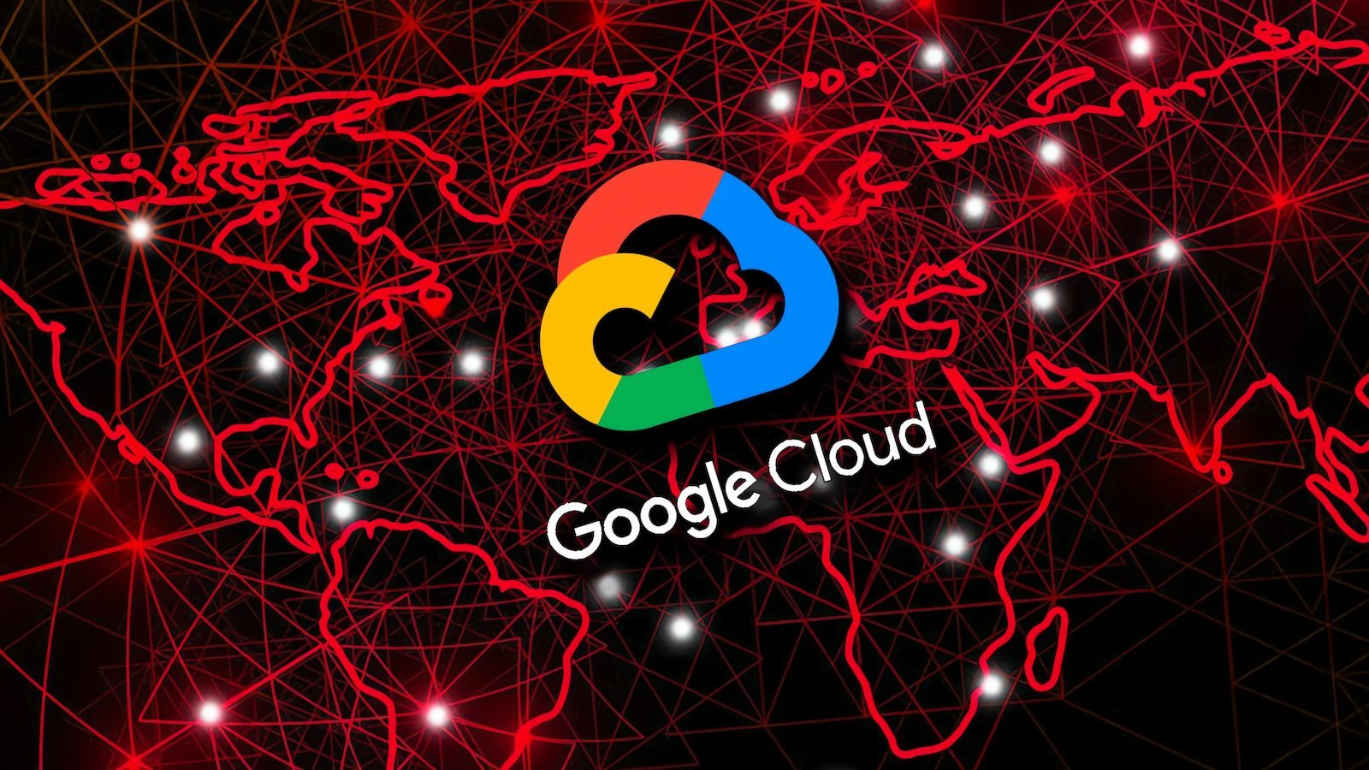
Event 3: Google Cloud Crash in 2019
https://status.cloud.google.com/incident/storage/19002

Slide 8
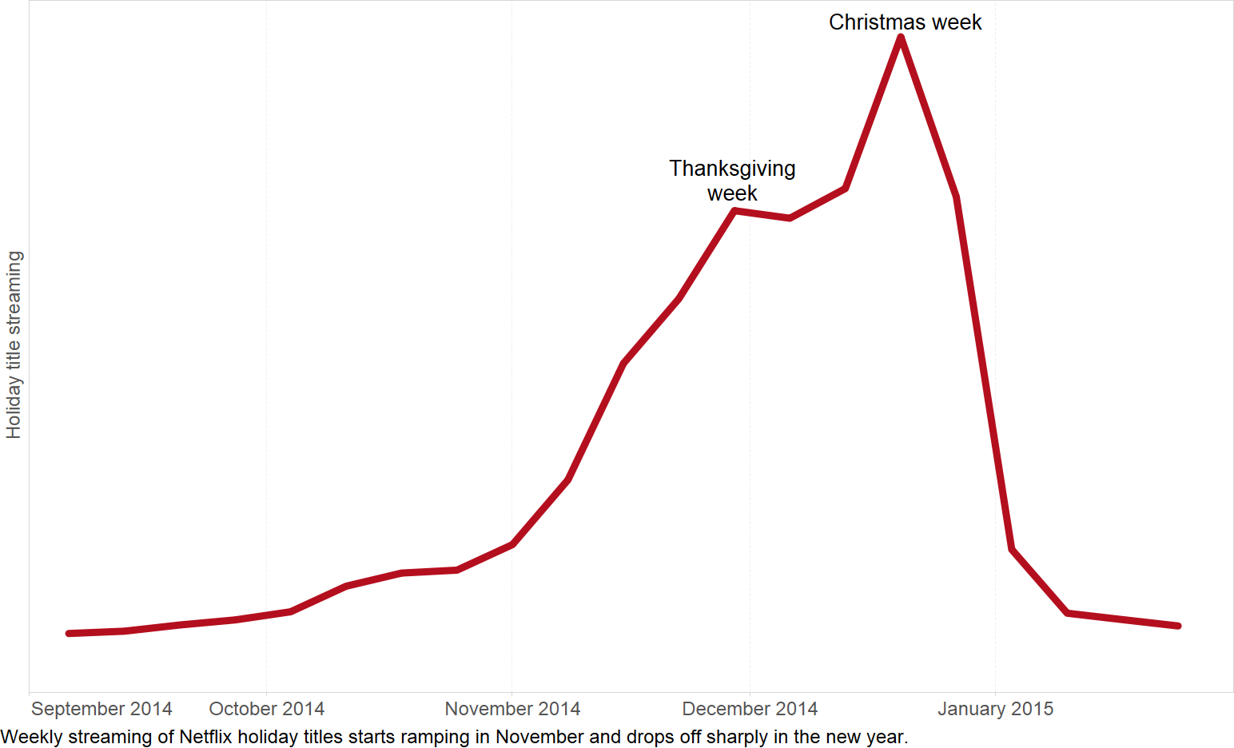
Event 4: Netflix Cache Optimization 2014/15

Slide 9
Question: If you are a medium size company, and you are out of service for a week, would you survive?

Slide 10
Question: What Are Microservices?
Microservices is an architectural style where a system is built as a set of small, independently deployable services. Each service owns one business capability (and its own data) and communicates with others via well-defined APIs.

Slide 11
Microservices?
Consider a Ride Sharing Application
Authentication
Trip
Payment
Messaging
Maps
Notification
Single responsibility: one business capability per service
Independent deployability: ship one service without redeploying the rest
Own your data: no shared database; each service controls its datastore
Automated ops: CI/CD, observability, and resilient runtime are mandatory

Slide 12
How to Get There
Starting Point: Modular Monolith
Every system starts somewhere. Instead of jumping straight to microservices chaos, start:
A Modular Monolith:
One codebase
Clearly defined modules
Enforced boundaries
Identify Bounded Contexts
Pick the First Service to Extract:
Start with low risk, high cohesion feature, e.g., Notification
Doesn’t depend on other services
Doesn’t need strong consistency
Easy to version and test
Define Strong API Contracts
Give Each Service Its Own Data
[Monolith]
↓
[Identify Bounded Contexts]
↓
[Extract First Service (e.g., Notifications)]
↓
[Expose API + Own DB]
↓
[Send Events (Kafka, RabbitMQ)]
↓
[Deploy with CI/CD]
↓
[Gradually Shift Traffic]
Rinse and Repeat!

Slide 13
Misconception
Don’t extract by layers like:
Auth API → its own service
DAO → its own service
Extract by business domains:
Trip Service
Rider Profile Service
Payment Processor
self-contained, resilient, and scale independently

Slide 14
When Not to Use Microservices (and Why)
Just Because You Can Doesn’t Mean You Should
Microservices are not a free performance boost. They introduce:
More moving parts
More ops complexity
More failure modes
Early-stage product / small team: You’ll spend more time on infra than features.
A well-structured monolith ships faster and is easier to reason about.
Simple domain / low scale: Microservices add network, data, and ops complexity you don’t need.
No platform maturity: Without automation (CI/CD, observability, infra as code), it’s a recipe for disaster
Tightly Coupled Features
Strict consistency across many boundaries: Cross-service ACID is hard

Slide 15
Common Misconception
Question | If "Yes" → Stay Monolith
MVP stage? | ✅
Small dev team? | ✅
Low domain complexity? | ✅
No CI/CD? | ✅
Features tightly coupled? | ✅
“Microservices = better scalability”
Reality:
You can scale a monolith horizontally (replicas)
Badly designed microservices become distributed chaos

Slide 16
You’re building a todo app for 300 users. Would you microservice it?
What about hosting in your local server? Yes/No?

Slide 17
Question:Why don’t we host the server on our premise? Why AWS / Azure?

Slide 18
Why don’t we host the server on our premise?
Cost
Building and managing data center not easy
Hardware
Not cheap
If your hardware burns, you lose everything
Maintenance
If the power goes out, your app goes down
If your ISP fails, you go offline
Security
But the actual reason?
If you are a medium size company, and you are out of service for a week, would you survive?
A startup hosts its entire ride-sharing backend (API, DB, payments) on one instance. That’s on the company’s premise.
During a memory leak (or internet crash), the instance crashes, and all ride requests fail for 12 hours.

Slide 19
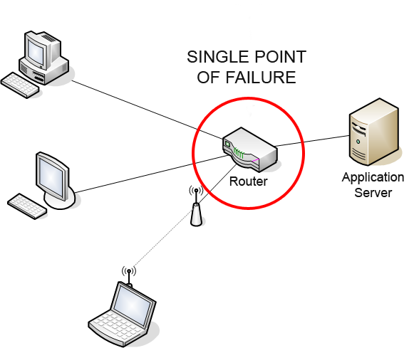
Single Point of Failure
A Single Point of Failure is any component that can bring down the whole system if it fails.

Slide 20
Single Point of Failure
A Single Point of Failure is any component that can bring down the whole system if it fails.
What’s the solution then?
Replication
Multiple servers
Load balancers
Deploy across multiple availability zones
Sharding and Partitioning

Slide 21
Database Replication
Consider A Ride Sharing App: Your ride app stores everything in a PostgreSQL database: users, trips, driver locations. Initially, there’s just one database. If it crashes → all data access stops.
So, you add replication:
Primary DB (handles writes: adding trips, updating driver positions).
Replica DBs (handle reads: fetching trip history, showing nearby drivers).
If the primary goes down, one replica can automatically be promoted to take its place.
Uber and Lyft both use database replication across data centers. When one region’s database fails, another replica in a different region takes over seamlessly.

Slide 22
Multiple Servers
As your app grows, one server can’t handle all traffic. You add more servers!
Now you deploy:
3 API servers for user requests
2 background worker servers for processing payments and trip updates
1 caching server (like Redis) for fast lookups
If one API server fails, others keep responding
Netflix runs thousands of microservices, each replicated across multiple servers. When one instance fails, others instantly handle the traffic.

Slide 23
Load Balancing
Now that you have multiple servers, you need a load balancer in front.
Example:
Users → Load Balancer → [API1, API2, API3]
The load balancer checks which API server is healthy and routes traffic evenly. If one crashes or slows down, it’s temporarily removed from the pool.
AWS’s Elastic Load Balancer (ELB) automatically distributes traffic between EC2 instances. When one instance fails, ELB stops sending requests there, users never see an error.

Slide 24
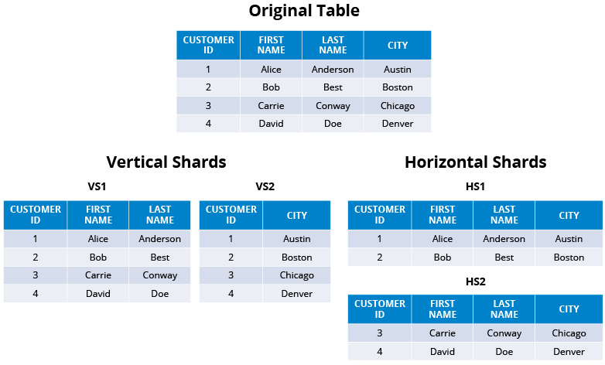
What’s difference between Sharding and Partitioning?

Slide 25
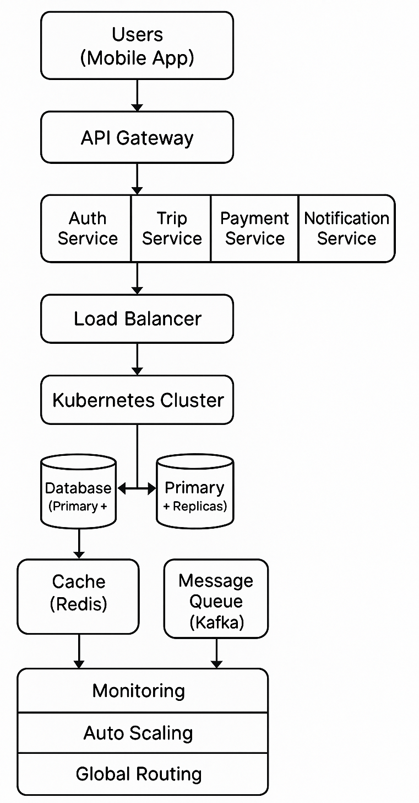
So How An Software Looks Like In Practice
Users (Mobile App)
↓
API Gateway → Auth Service → Trip Service → Payment Service
↓ ↘
Load Balancer ↘
↓ Notification Service
Kubernetes Cluster
↓
Database (Primary + Replicas)
↓
Cache (Redis) + Message Queue (Kafka)
↓
Monitoring + Auto Scaling + Global Routing

Slide 26
Problem with Replication
In 2017, a major outage hit GitLab because of a single configuration change in replication.
300GB of data lost
6 hours downtime
5,000 projects unrecoverable
Manual recovery from 6-hour-old backup snapshot

Slide 27
Problem with Replication
In 2017, a major outage hit GitLab because of a single configuration change in replication.
Why?
An engineer accidentally deleted the production database while cleaning backups
Replication was misconfigured, so all replicas had already mirrored the deletion
Replication ≠ Backup
Replication doesn’t protect you from bad code
Backups and write-protection layers do
Mitigations:
Immutable backups (e.g., AWS Backup Vault Lock)
Configuration as code (Terraform, Ansible)
Staging environments with automatic drift detection
Feature flags to control risky rollouts

Slide 28
Problems of Automatic Failover
In March 2019, Google Cloud Storage experienced a multi-hour outage in the US multi-region bucket service:
https://status.cloud.google.com/incident/storage/19002
On Monday 11 March 2019, Google SREs were alerted to a significant increase in storage resources for metadata used by the internal blob service. On Tuesday 12 March, to reduce resource usage, SREs made a configuration change which had a side effect of overloading a key part of the system for looking up the location of blob data. The increased load eventually lead to a cascading failure.

Slide 29
“Self-Healing” System
You have a database cluster that looks like this:
PRIMARY (Main DB)
↓ (Replicates data)
REPLICA 1
REPLICA 2
The primary handles all writes (inserts, updates, deletes).
The replicas are read-only copies that receive data updates from the primary.
If the primary fails, a replica can be promoted to take its place, this is called failover.

Slide 30
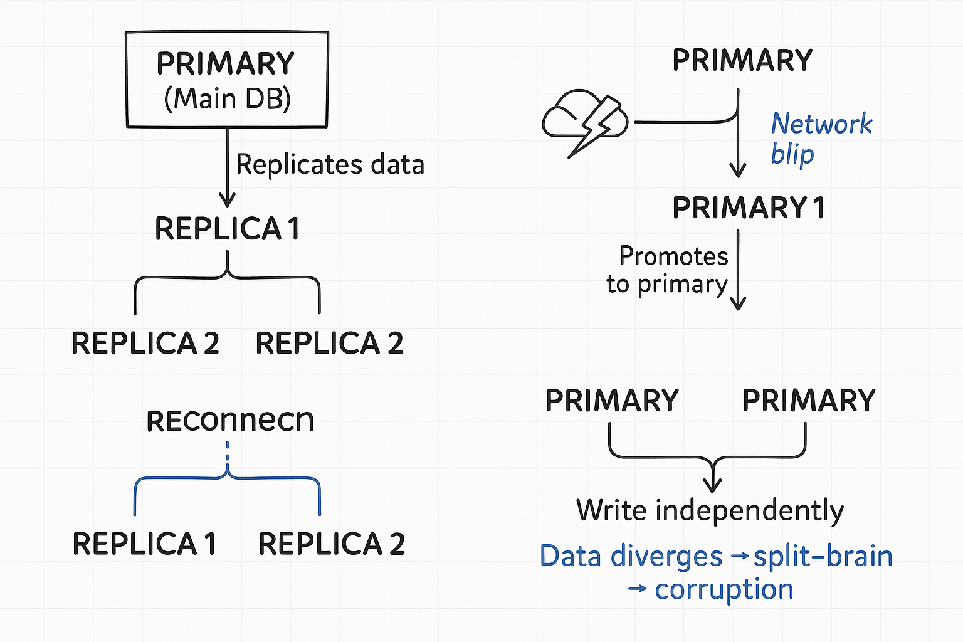
Now assume
The primary is healthy, serving traffic
Suddenly, a network hiccup makes it invisible to the replicas for 10 seconds
The replicas panic: “Primary is dead! We must promote a new one!”
One replica becomes the new primary, starts accepting writes
At this point, you have two primaries: one old (temporarily disconnected) and one new (recently promoted).
When the network recovers…
The old primary is back online, still thinking it’s in charge.
The new primary is also writing data.
Both are accepting client writes independently.
This is called a split-brain situation

Slide 31
Why It Happens
Because “automatic failover” assumes failure detection = actual death
But in distributed systems, that’s often not true
Temporary network issues can look like failure, even when the node is healthy
This is the core problem of distributed systems:
it’s impossible to tell the difference between
“the node is dead”
and
“the node is just not reachable right now.”
This is known as the FLP Impossibility (FischerLynchPaterson theorem).

Slide 32
How Real Systems Prevent It
Professional database clusters (like PostgreSQL with Patroni, MySQL Group Replication, or MongoDB Replica Sets) use quorum and consensus algorithms (like Raft or Paxos) to prevent this
Don’t trust a single replica to decide that the primary is dead
Instead, require a majority vote (a quorum) among nodes
Let’s say:
Cluster has 5 nodes.
If only 1 node loses contact with the primary → no failover
If 3 or more agree the primary is unreachable → elect a new one

Slide 33
Problem: When Load Balancer Becomes “SPOF”
You put one NGINX in front of ten healthy app servers. Traffic explodes; everything looks smooth… until that single NGINX VM gets a kernel panic. Your ten perfect servers are invisible. The “protector” was the weakest link.

Slide 34
Problem: When Load Balancer Becomes “SPOF”
You put one NGINX in front of ten healthy app servers. Traffic explodes; everything looks smooth… until that single NGINX VM gets a kernel panic. Your ten perfect servers are invisible. The “protector” was the weakest link.
October 2025: AWS experienced a large outage in its US-East-1 region. One of the root causes was a failure in the ELB (Elastic Load Balancer) subsystem: the load balancers lost visibility or control over backend server health and routing.

Slide 35
Mitigations
Deploy redundant load balancers (e.g., AWS ALB + CloudFront + Route 53)
Use DNS-based failover across multiple balancers
Always test failover manually→ many teams never do

Slide 36
Question: When (Not) to Add More Servers?
“System slow? Add more servers!”
More servers = faster performance, right? Yes/No?

Slide 37
When (Not) to Add More Servers?
Netflix once saw latency spikes in recommendations
Engineers wanted to double servers
Profiling showed 70% of time was spent recomputing the same results
They added caching → latency dropped 10× with no extra servers
https://netflixtechblog.com/application-data-caching-using-ssds-5bf25df851ef
Netflix added servers → No improvement
Added cache → 10x improvement Insight: Optimize before scaling

Slide 38
When (Not) to Add More Servers?
Bottleneck Is in the Database:
Adding more app servers won’t help if the database is choking
Example: 50 servers sending 10× queries to a single Postgres instance → You’ll overload the DB even faster
Fix:
Add read replicas or caching (Redis, Memcached)
Optimize queries, indexes, and batch writes
I/O or Network Bottleneck: If network latency, bandwidth, or file I/O is the issue, scaling compute won’t fix it
Example: Each API server waits on slow I/O (e.g., third-party API)
→ Add caching or async job queues instead
CPU vs Memory Bound Workloads
Sometimes, CPU utilization is fine (30%), but RAM is full or vice versa
Fix:
Match instance type to workload (e.g., r6g for memory-heavy, c7g for compute)
Don’t scale horizontally until vertical optimization is exhausted

Slide 39
What trade offs would you accept in the database layer if latency is critical?
When you need real-time or near-instant response systems (e.g., recommendation engines, stock trading, messaging)

